Slide 1
Agile Principles & Manifesto
- Prof K G Krishna

Slide 2



Text/Reference Books
T1
T2
Compliments of IBM
➔ As this field is evolutionary, the student is advised to stay tuned to the current and emerging practices by referring to their own organization’s documentation as well as Net sources

Slide 3
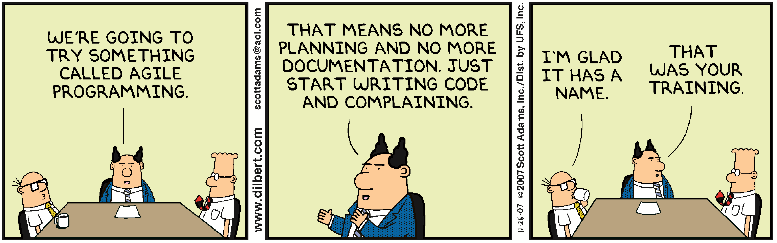
Topics
Principles of Agile
Agile Values
Agile Manifesto

Slide 4
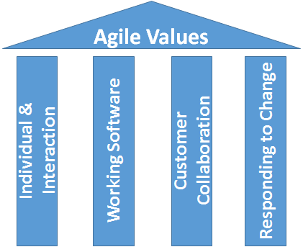
Agile Core Values…

Slide 5
Agile Principles…
Principles behind the Agile Manifesto
We follow these principles:
Our highest priority is to satisfy the customer through early and continuous delivery of valuable software.
Welcome changing requirements, even late in development. Agile processes harness change for the customer's competitive advantage.
Deliver working software frequently, from a couple of weeks to a couple of months, with a preference to the shorter timescale.
Business people and developers must work together daily throughout the project.
Build projects around motivated individuals. Give them the environment and support they need, and trust them to get the job done.
The most efficient and effective method of conveying information to and within a development team is face-to-face conversation.
Working software is the primary measure of progress.
Agile processes promote sustainable development.
The sponsors, developers, and users should be able to maintain a constant pace indefinitely.
Continuous attention to technical excellence and good design enhances agility.
Simplicity--the art of maximizing the amount of work not done--is essential.
The best architectures, requirements, and designs emerge from self-organizing teams.
At regular intervals, the team reflects on how to become more effective, then tunes and adjusts its behavior accordingly.
Source courtesy: agilemanifesto.org

Slide 6
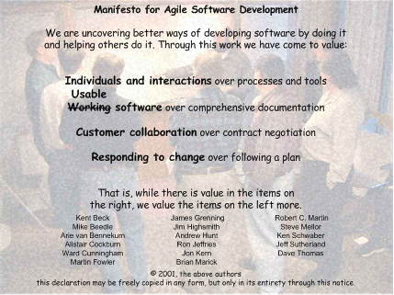
Agile Manifesto (2001)
Source courtesy: agilemanifesto.org

Slide 7
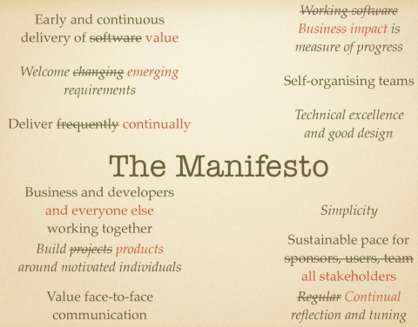
Agile Manifesto (adapted to times)
Source: https://www.ncsc.gov.uk/blog-post/securing-agile-delivery-collaboration-crucial

Slide 8
9 Principles Agile Project Manager
Deliver something useful to the client; check what they value
Cultivate committed stakeholders
Employ a leadership-collaboration style
Build competent, collaborative teams
Enable team decision making
Use short time-boxed iterations to quickly deliver features
Encourage adaptability
Champion technical excellence
Focus on delivery activities, not process-compliance activities
The Agile Project Manager
Devolve of both control and planning to the entire team, not the manager
The manager does not create WBS, schedule, estimates or tell people what to do
The manager does not define and assign detailed team roles and responsibilities
Source: (T1-Chap3) Jim Highsmith, Agile Alliance Founder

Slide 9
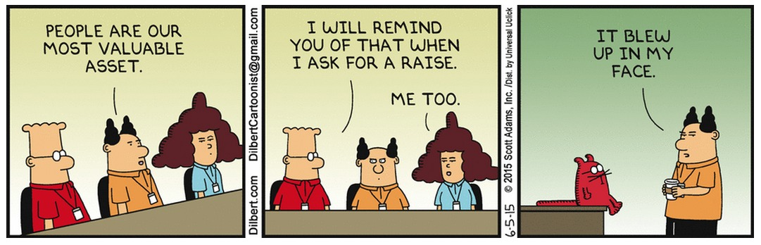
The Human Touch in Agile
“People are more important than any process. Good people with a good process will outperform good people with no process every time” – Grady Booch
Programming is an intense Human Activity - People matter much more than Machines
Individuals and Interactions over Processes and Tools
Sustainable Pace – Programmers to maintain a healthy social and family life
Respect Diversity of Individual Contributions – Skill Transfer through Pair Programming
Preference for Direct Face-to-Face Communication over Virtual Meetings or Remote Teams
…

Slide 10
Agile Principles & Manifesto - Summary
Programming as if People Matter Most
Customer is at the Centre – The Key Stakeholder
Adapt to the Reality: Requirements keep Changing till the End of the Project
Continuous and Incremental Delivery with a series of Working Product Releases
Involve All Stakeholders Early-on
Focus on Delivery over Process-compliance
Close-knit Communication and Collaboration among Teams
Agile Project Manager is the Leader and Motivator – Not the Boss of Manager of People
Collective and Collaborative Decision-making
…

Slide 11
Thank You
© Copyrights of original Authors are duly acknowledged
™ ® All Trademarks, Registered Trademarks referred in this document are the property of their respective owners

